Slide 1
Sanitary Engineering
Sewerage Engineering
Secondary Treatment System
By
Dr. Muhanad M. Abbas

Slide 2
Suspended Growth Process

Slide 3
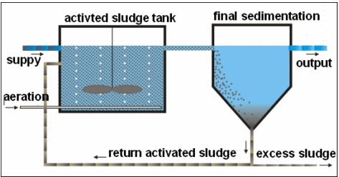

Slide 4
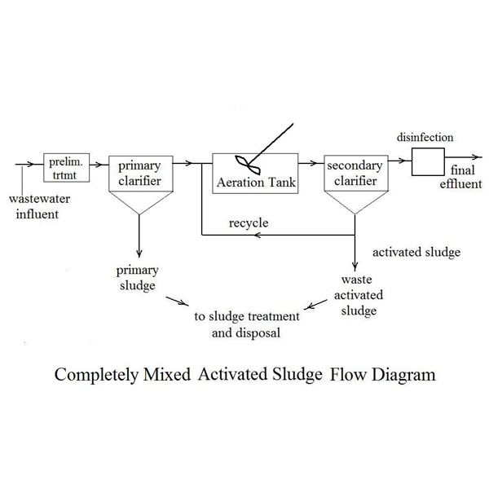

Slide 6
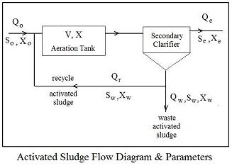

Slide 8
